Slide 1
Selling online with Shopify Fall 2020
Notes:
Thanks for coming..
About me.. What is an entrepreneur?
What is Ecommerce & how is it different than a Brick & Mortar?
Online store vs marketplace? Pros and cons
I would like to note, as I go through all of the information today, please think about 3 actionable tasks you might be able to take away from today and apply to your business.

Slide 2
Agenda
01
Intro to Shopify
02
Start
03
Sell
04
Market
05
Manage

Slide 3

What is Shopify?
Notes:
What is Shopify?

Slide 4
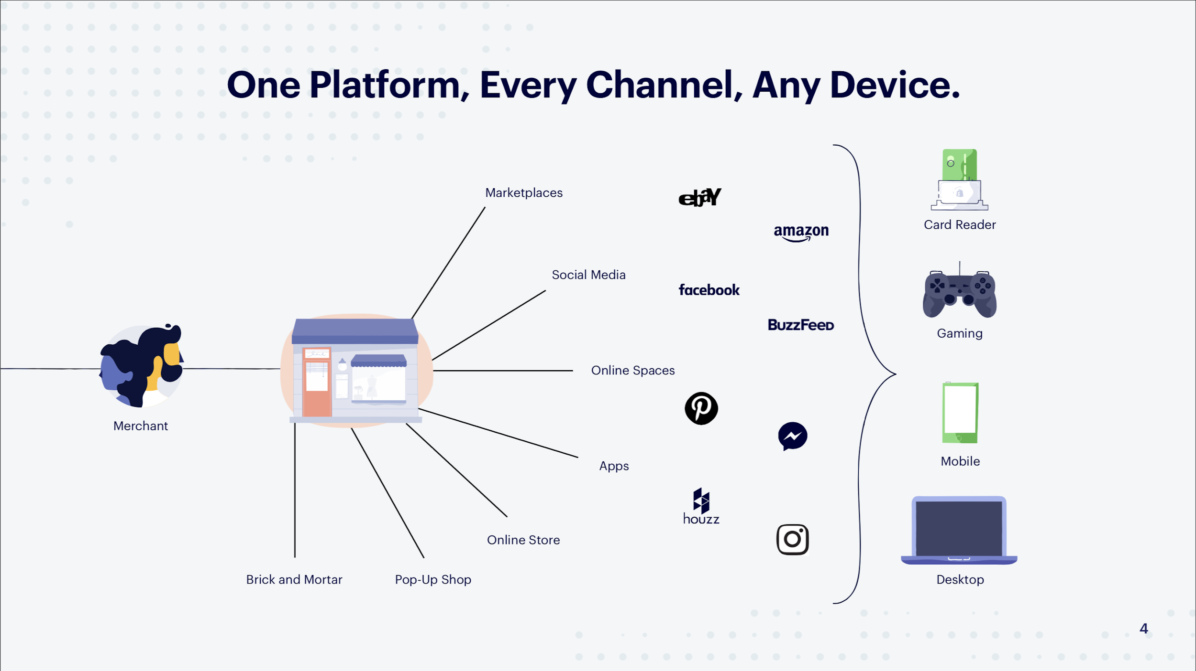
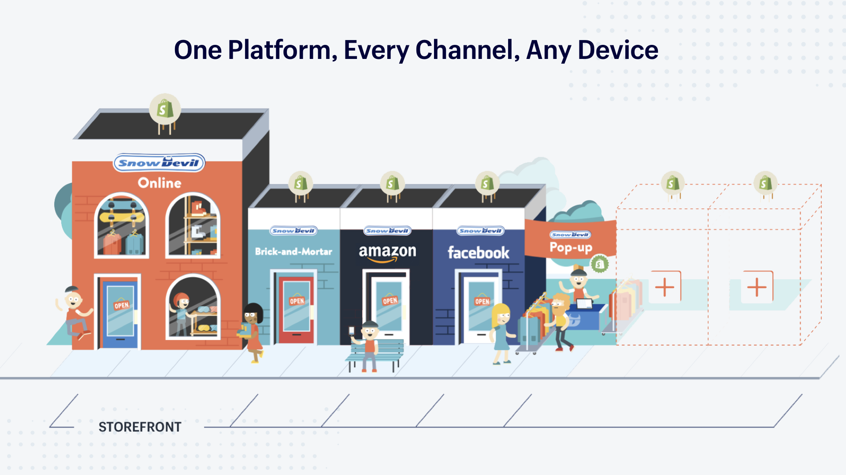
Notes:
So what is Shopify? We are a cloud-based, multi-channel commerce platform designed to help you run your business.
Shopify allows you to design, set up and manage your stores across multiple sales channels, including web, mobile, social media, marketplaces, brick-and-mortar locations, and pop-up shops.

Slide 5
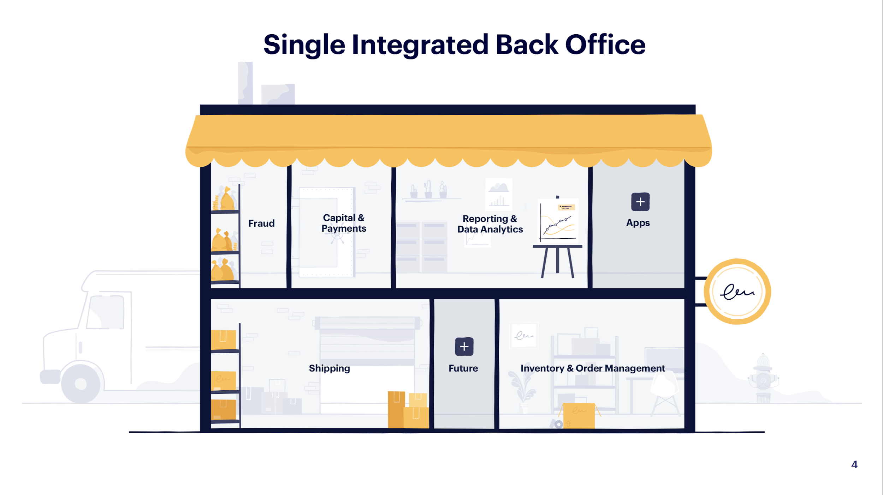
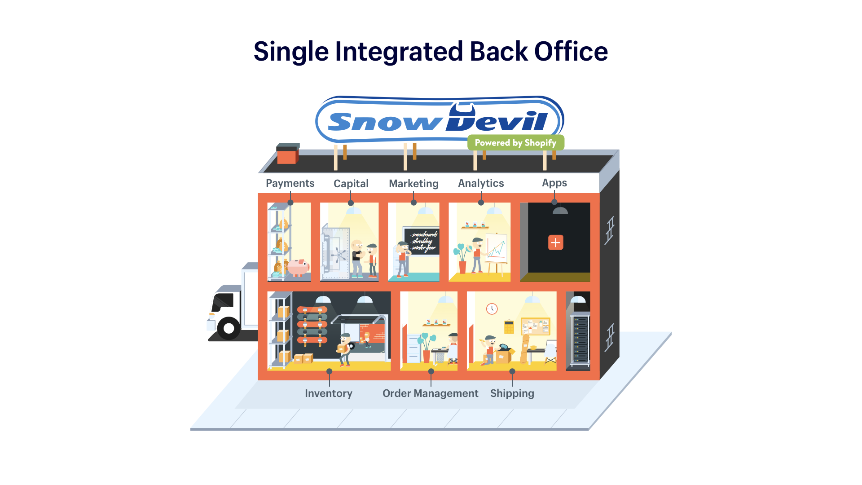
Notes:
Running a business means staying on top of lots of moving parts. Shopify makes this easier for merchants by providing one mission control for their business. From your Shopify Admin, you can keep an eye on all components of your business, including processing and shipping orders, managing inventory, running ads and ensuring things are running smoothly.

Slide 6
At a Glance
1M+
merchants
$202B sales on Shopify
175+
countries
5K+ employees
Notes:
Shopify caters to businesses of all sizes, from side hustles up to multi-million dollar corporations.
We have over 1 million merchants in over 175 countries using our platform.
Consumers have purchased over $202 BILLION worth of product from Shopify merchants and we now have over 5000 employees Making Commerce Better for Everyone.

Slide 7





























Our merchants
Notes:
Quick snapshot of some of the brands you’ll find on Shopify. You’ll probably recognize a few of these and maybe even shop at some of them!

Slide 8
Necessity is the
mother of invention
Notes:
Quick synopsis of the origin story
2006 Tobi saw an opportunity, and began the dream to make it happen
Merchant driven company, Tobi himself was looking for a way to sell, and therefore Merchants are at the centre of our mission statement, and every goal we look to achieve

Slide 9
Make commerce
better for everyone
Notes:
Straight forward mission - make commerce better for everyone (merchants, buyers, partners, etc)
For dreamers or large corporations - Shopify can power it
Our goal - To help you succeed. When you succeed, we succeed

Slide 10
02
Start

Slide 11
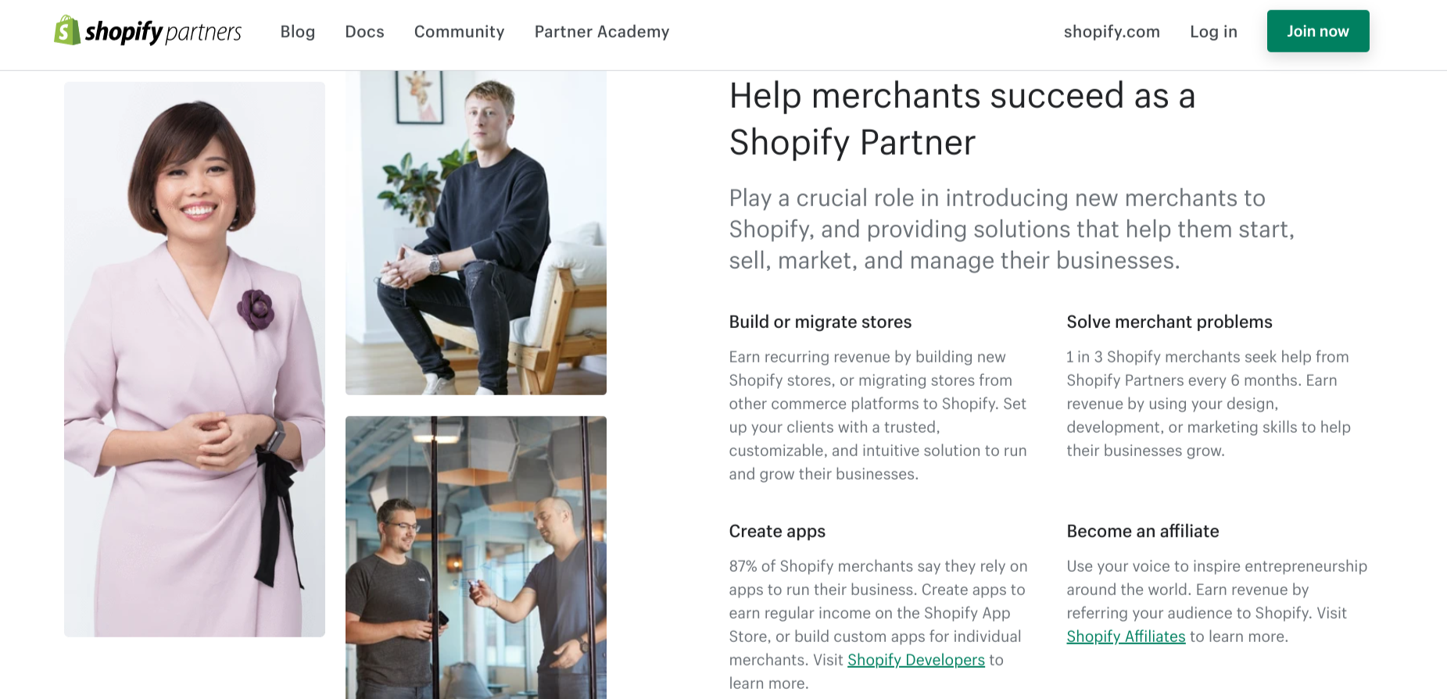

Slide 12
Things to Consider
Grants available from L.E.O.
Who will update and manage the store?
Shop Local is now very much online -check local organisations for campaigns
Cost, Competition and Content

Slide 13
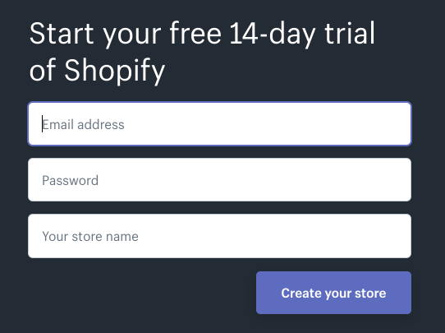
Create an account
Notes:
First thing you need to do is create an account - head to shopify.com
Simple form, takes minutes to complete

Slide 14
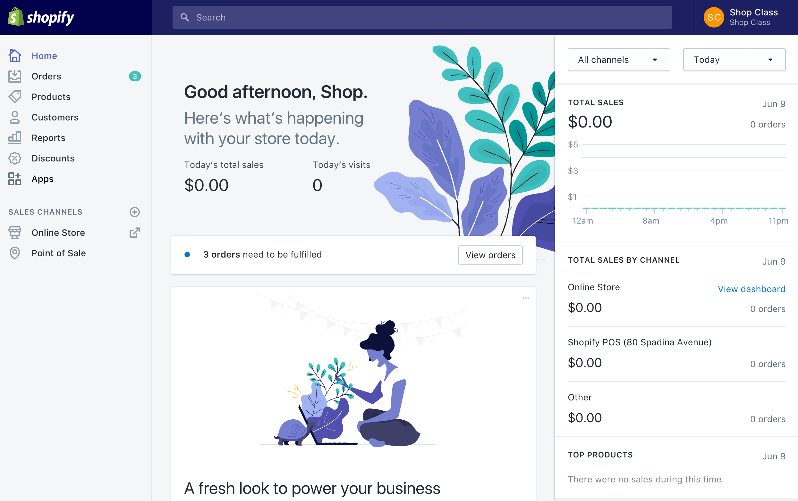
Home
Notes:
Once you create your account, you’ll be logged in to your Admin as pictured here
Home base, or control centre for your business
From here you can modify theme, add products, view and fulfill order, view reports and more
From launch to 100th sale, the Admin helps run your business

Slide 15
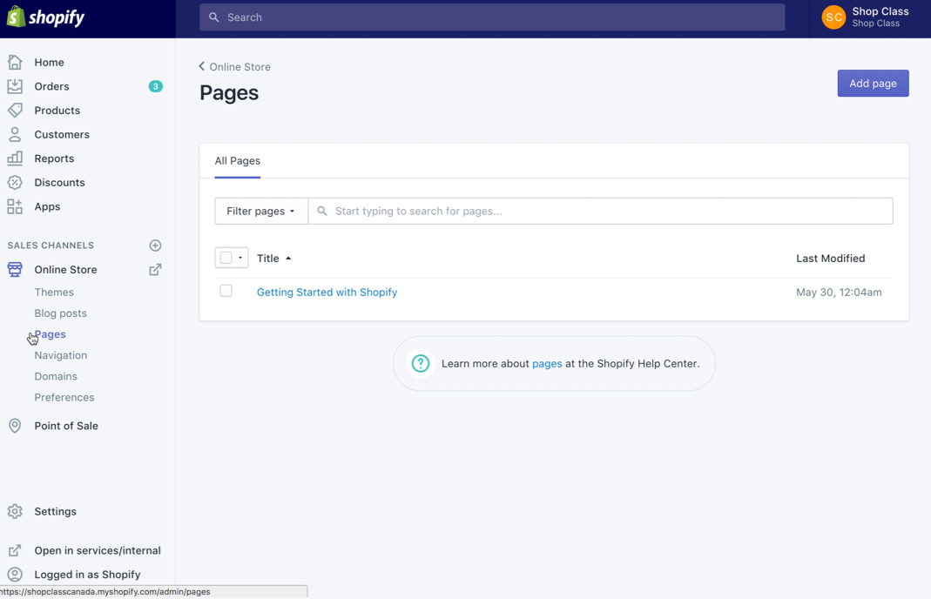
Pages
Built in real-time editor
Commonly used for About Us, Policies, FAQs, etc
Often overlooked
SEO
Help build trust with customers
Notes:
Pages are a great opportunity for you to tell your story and add-in personal touches. It’s here that you can let your customers know who you are, what you’re about, and even how to contact you. This can really help increase customer trust, and establish you as a brand.

Slide 16
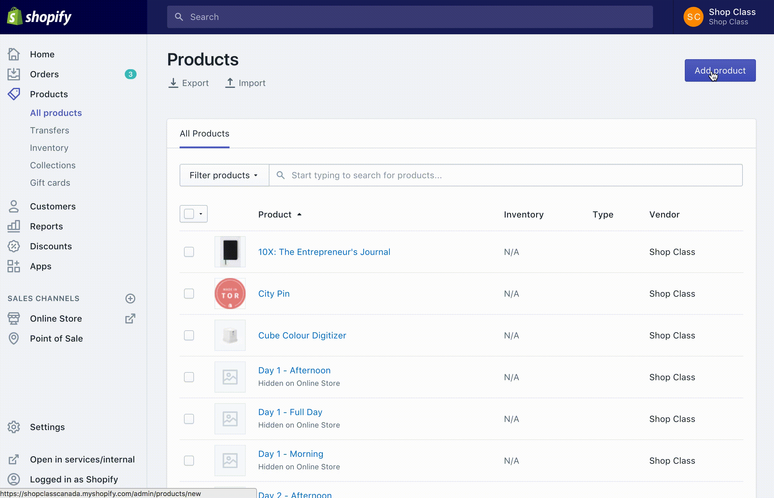
Products
Easy to add
Can be physical or digital
Can be set up with variants
Built-in inventory tracking
Grouped in collections
Notes:
Not just physical products - Digital goods and services too, with a variety of apps available to expand the functionality and help you protect your property/content
- Flexibility to sell what you want, where you want, how you want.
- Add up to 3 Options (color, size, material) for your variants
- Total of 100 Variants, though there are apps if you have more than 100 variants
- Basic inventory tracking - nobody wants supply issues
- Group products into collections

Slide 17
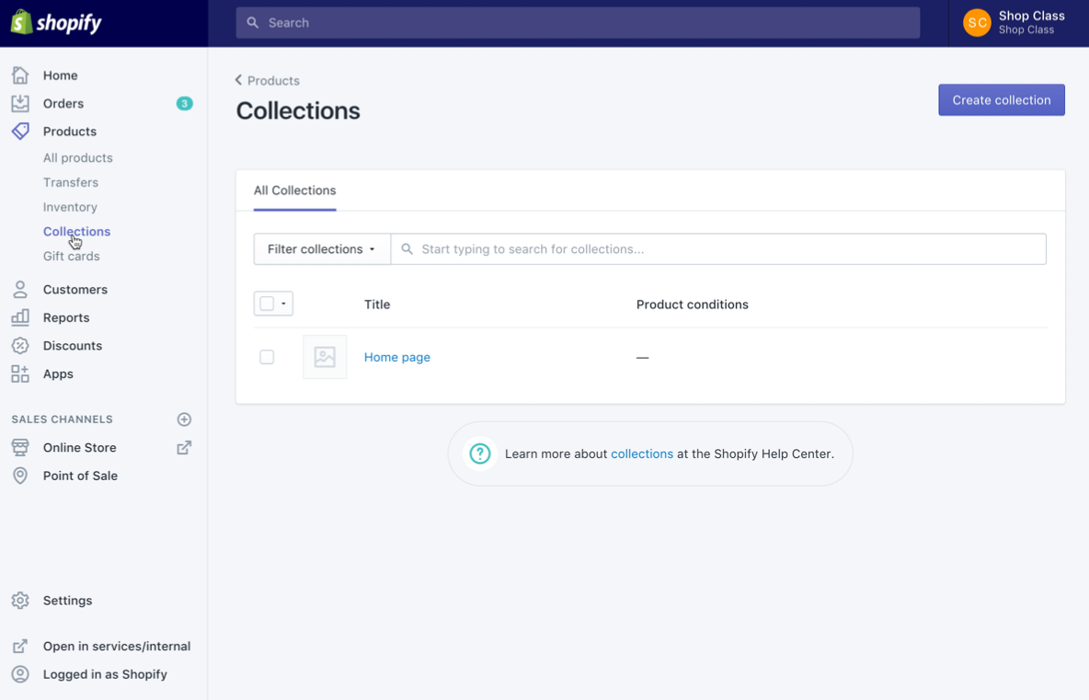
Collections
Easy way to categorize products
Created manually or automatically
Helps customers browse
More enjoyable shopping experience
Notes:
You can create two types of collections in Shopify: automated collections and manual collections.
An automated collection uses selection conditions to automatically include matching products. You can define as many conditions as you want, and you can also specify whether products must meet all conditions or any condition to be included in the collection. When you add a new product that matches the selection conditions for a collection, it will be automatically added to the collection.
A manual collection includes the products you add. The collection always contains the same products unless you add or remove them.
Here are a few examples of collections that you might create: apparel for men, women or children, items on sale, items in a specific size or color, seasonal products.

Slide 18
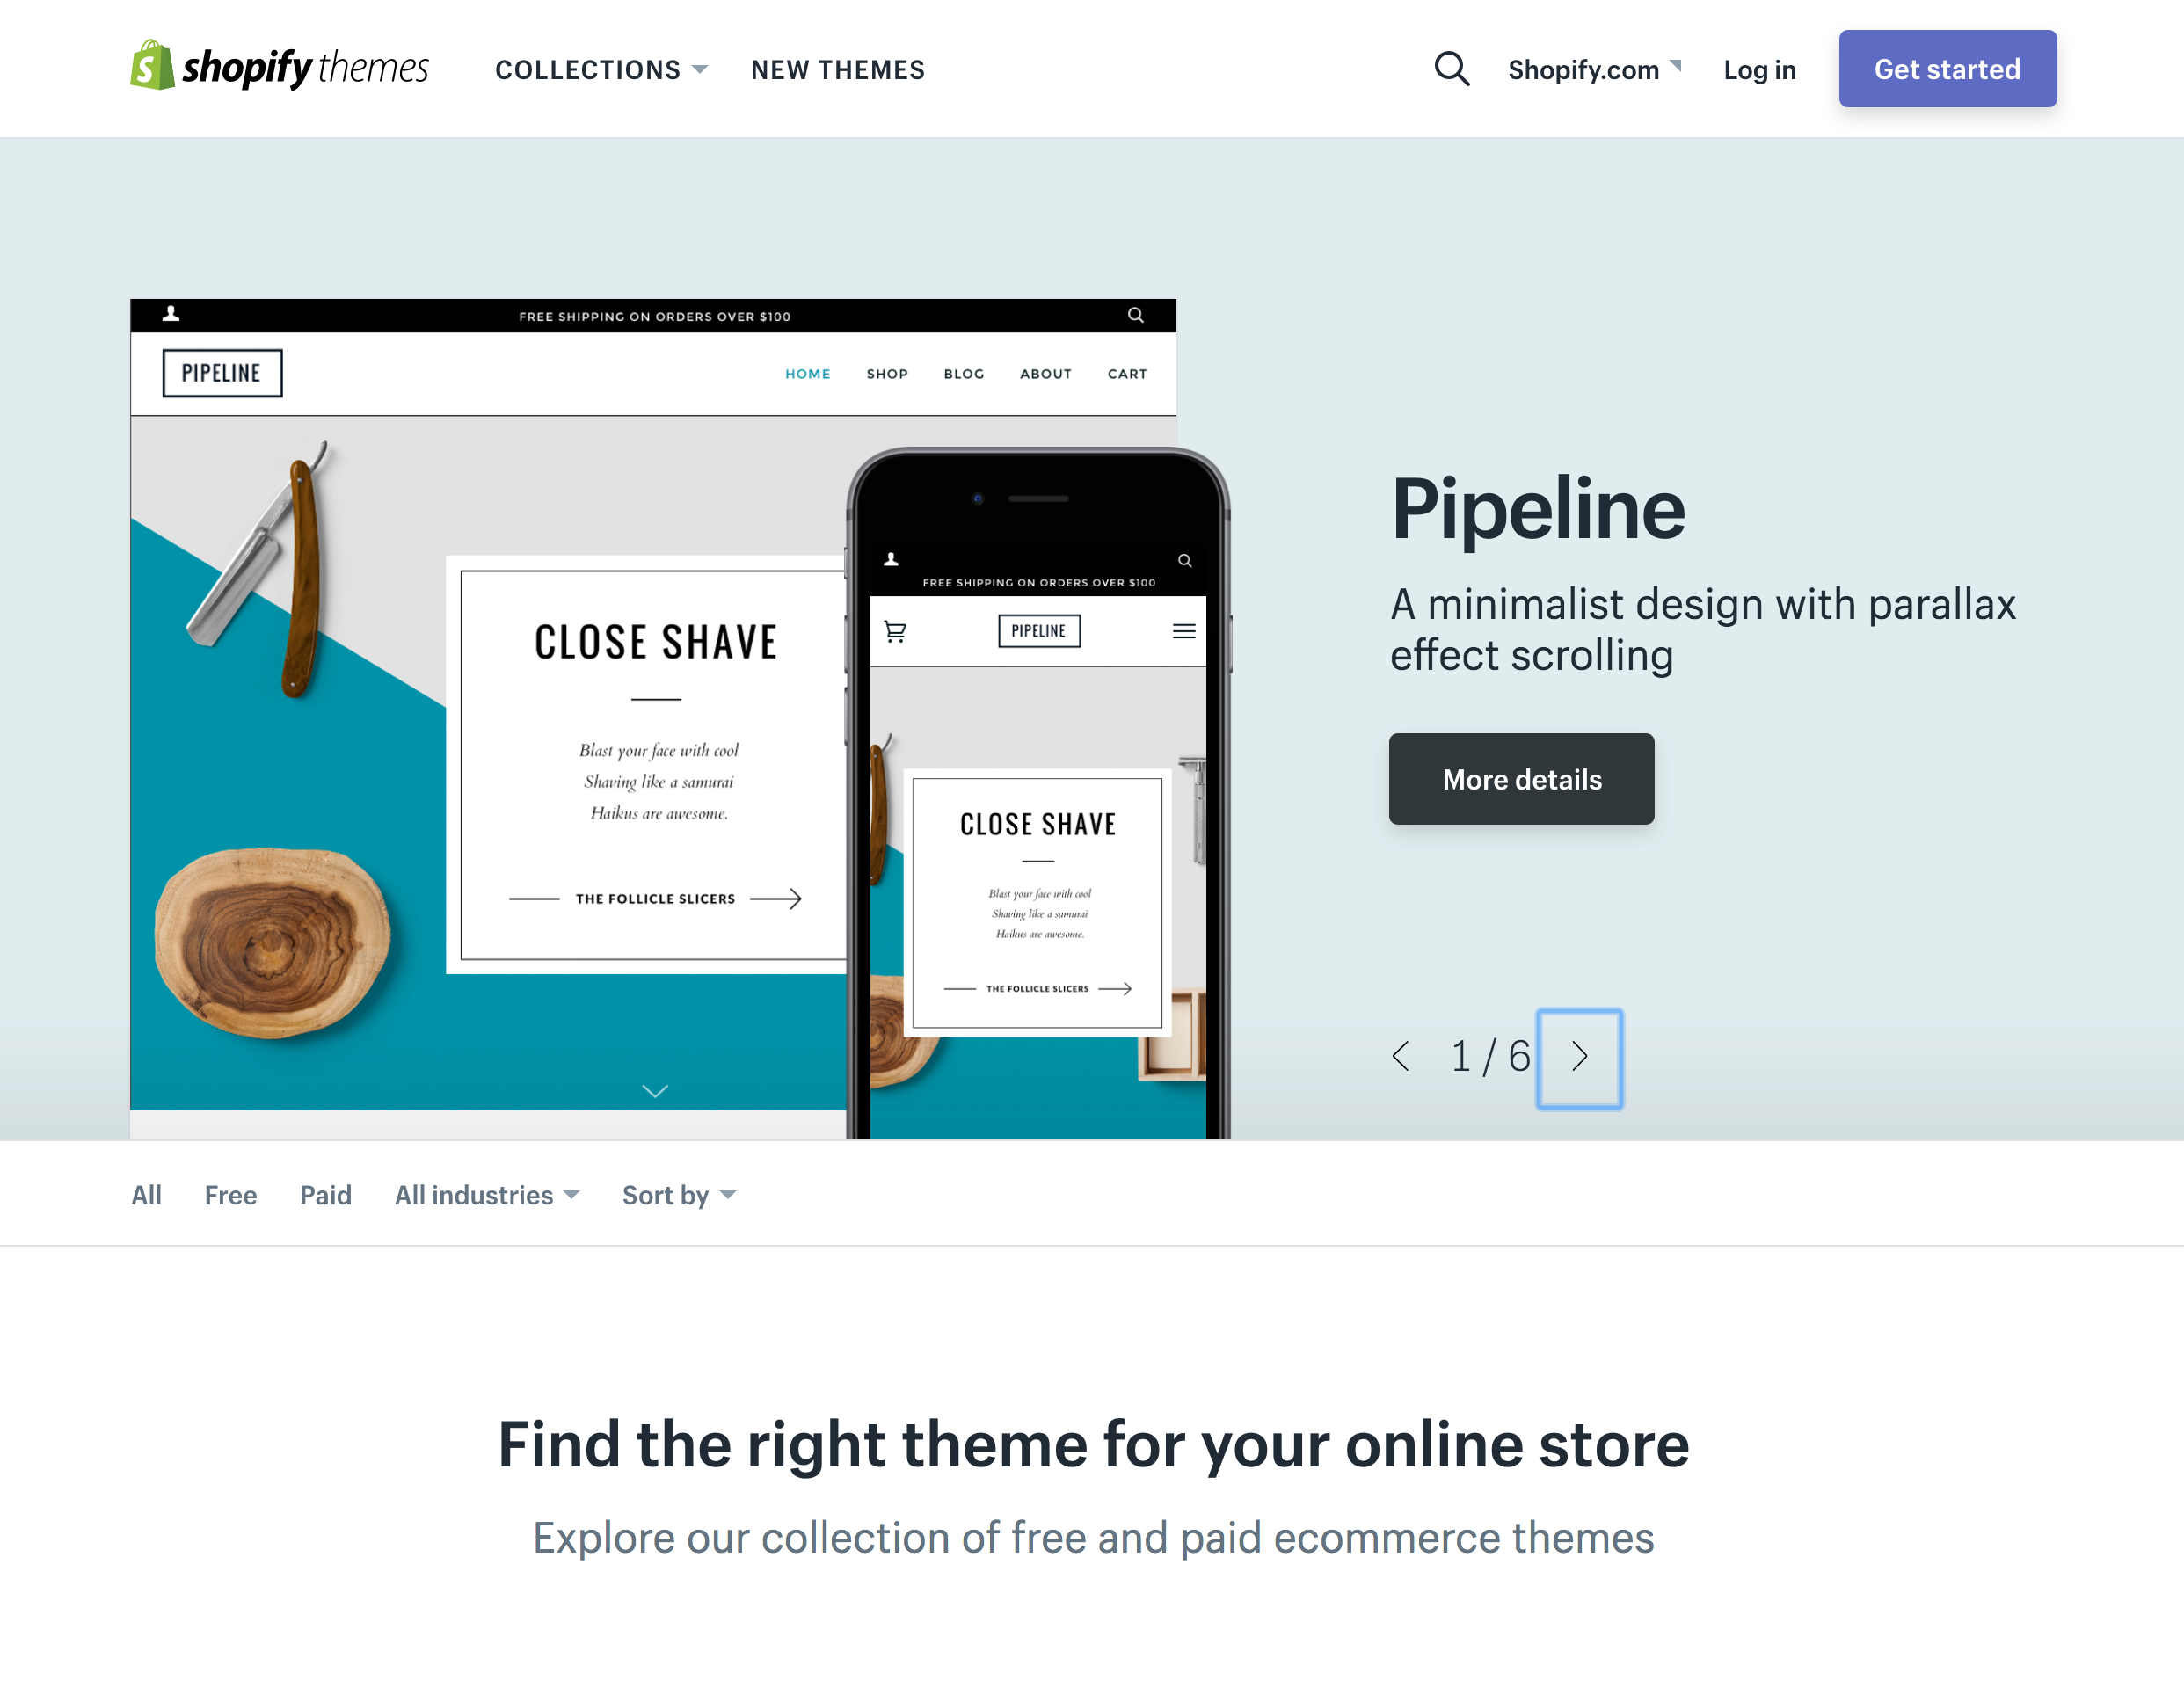
Themes
100+ themes available
Free or paid
All come with built-in theme editor
No coding required (unless you want to!)
Notes:
Themes.shopify.com to view them - themes are pre-built with a variety of layouts and features
over 100 themes in theme store - Free and Paid
all come with Theme Editor for basic changes like color schemes, logos, homepage design, etc
no coding needed, but you have full access to theme files if needed

Slide 19
03
Sell

Slide 20
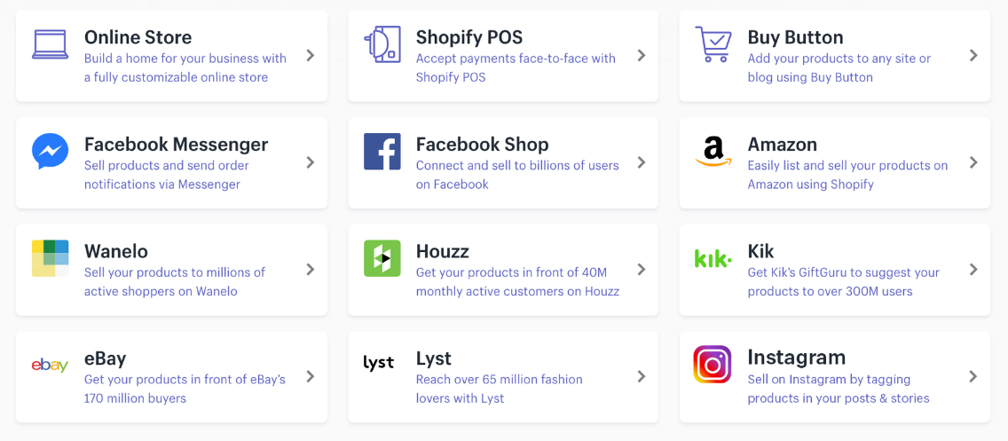
Sales channels
Notes:
Shopify is a platform that allows merchants to sell anywhere. Our roots are in ecommerce but we also enable our merchants to sell through multiple sales channels whether that’s on the web, in person at a retail location or pop up shop or on a third party platform or social media channel.
Sales Channels are a great option for you to expand your business and connect with your customers where they are already spending their time online. Some do come with eligibility requirements that must be met so that they can be used. Lean more at shopify.com/channels.

Slide 21
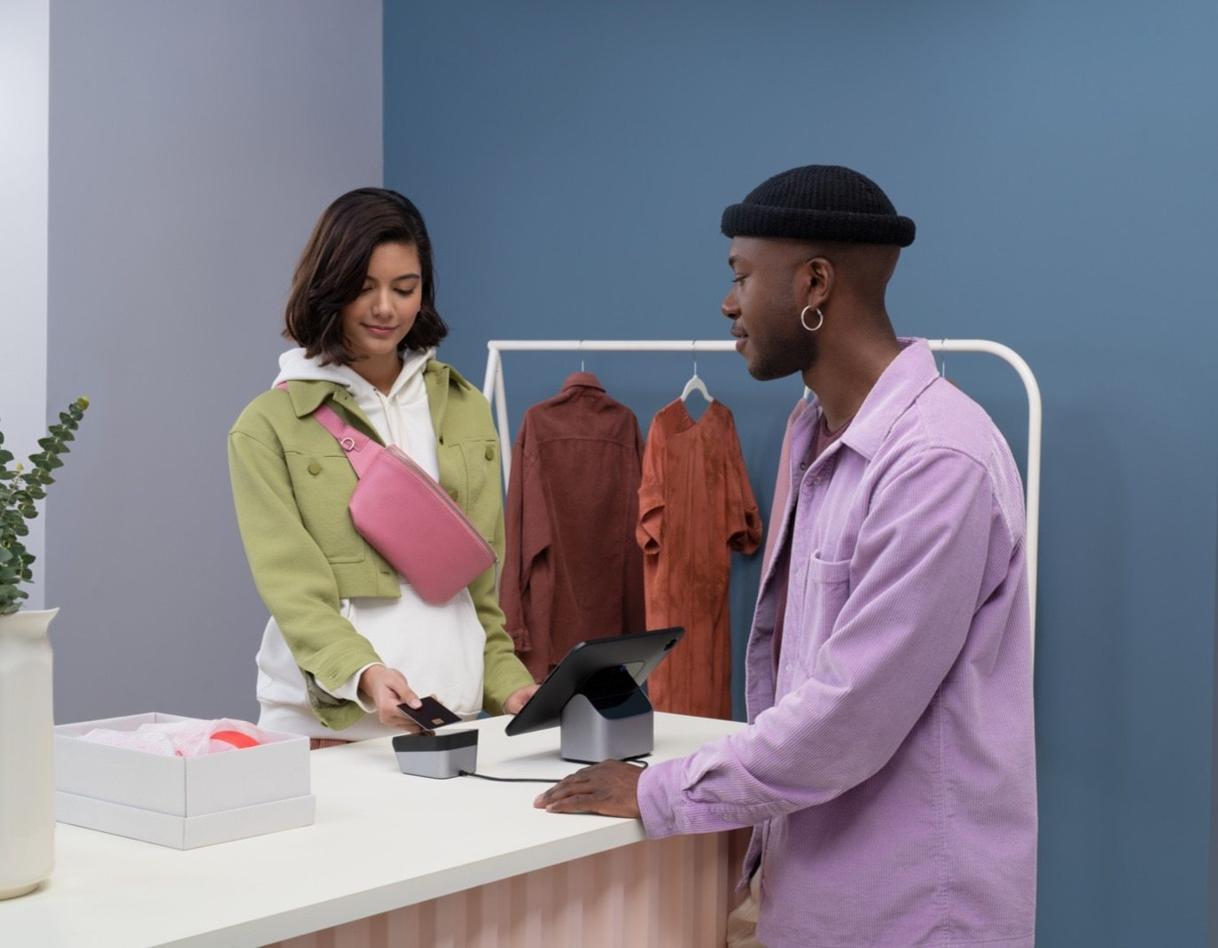
Shopify POS
Secure payments
Plug and play hardware
Advanced checkout
Built-in inventory management
Notes:
Shopify POS can help you sell in person, whether you do it occasionally through pop-ups or markets and fairs, or you are opening your 10th brick and mortar location. Accept credit cards and gift cards with easy to use hardware the syncs up with your online store. Maintain accurate inventory across all your POS locations. Learn more at shopify.com/POS.

Slide 22
04
Market

Slide 23
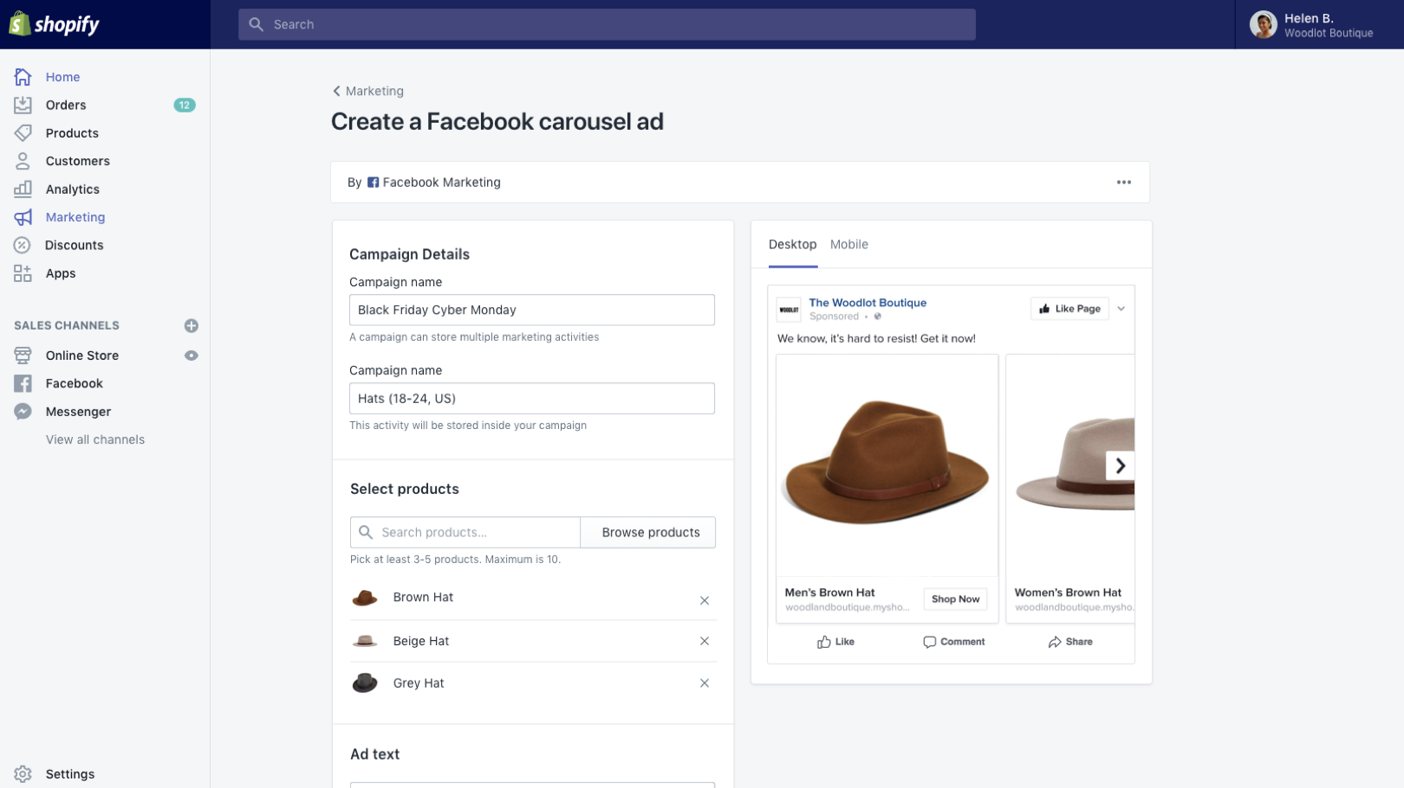
Shopify Marketing
Create Facebook ads and Google Shopping campaigns
Organize your marketing activities by campaign
Recommendations to help you grow your business
Notes:
Shopify makes it easy for you to market your business using integrated tools
Shopify merchants gain access to a marketing section within the Shopify Admin. Merchants can create smarter, multi-channel digital marketing campaigns that put their products in front of the right shoppers—without ever having to leave Shopify. You can create Facebook ads and Google Smart Shopping campaigns directly from the admin.

Slide 24
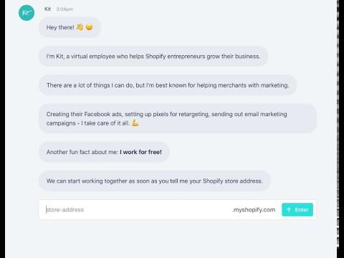
Kit
Your virtual marketing assistant
Create Facebook ads, send welcome emails to new customers, and more.
Notes:
Take the hassle out of marketing on your store, why not take a look at Kit?
Kit is a virtual employee for your Shopify store and can help drive sales by creating targeted Facebook ad campaigns and even crafting personal thank-you emails for customers on your store!
You can sign up and start using Kit for free, and you’ll only be billed after Kit has helped you make a few sales and social posts.

Slide 25
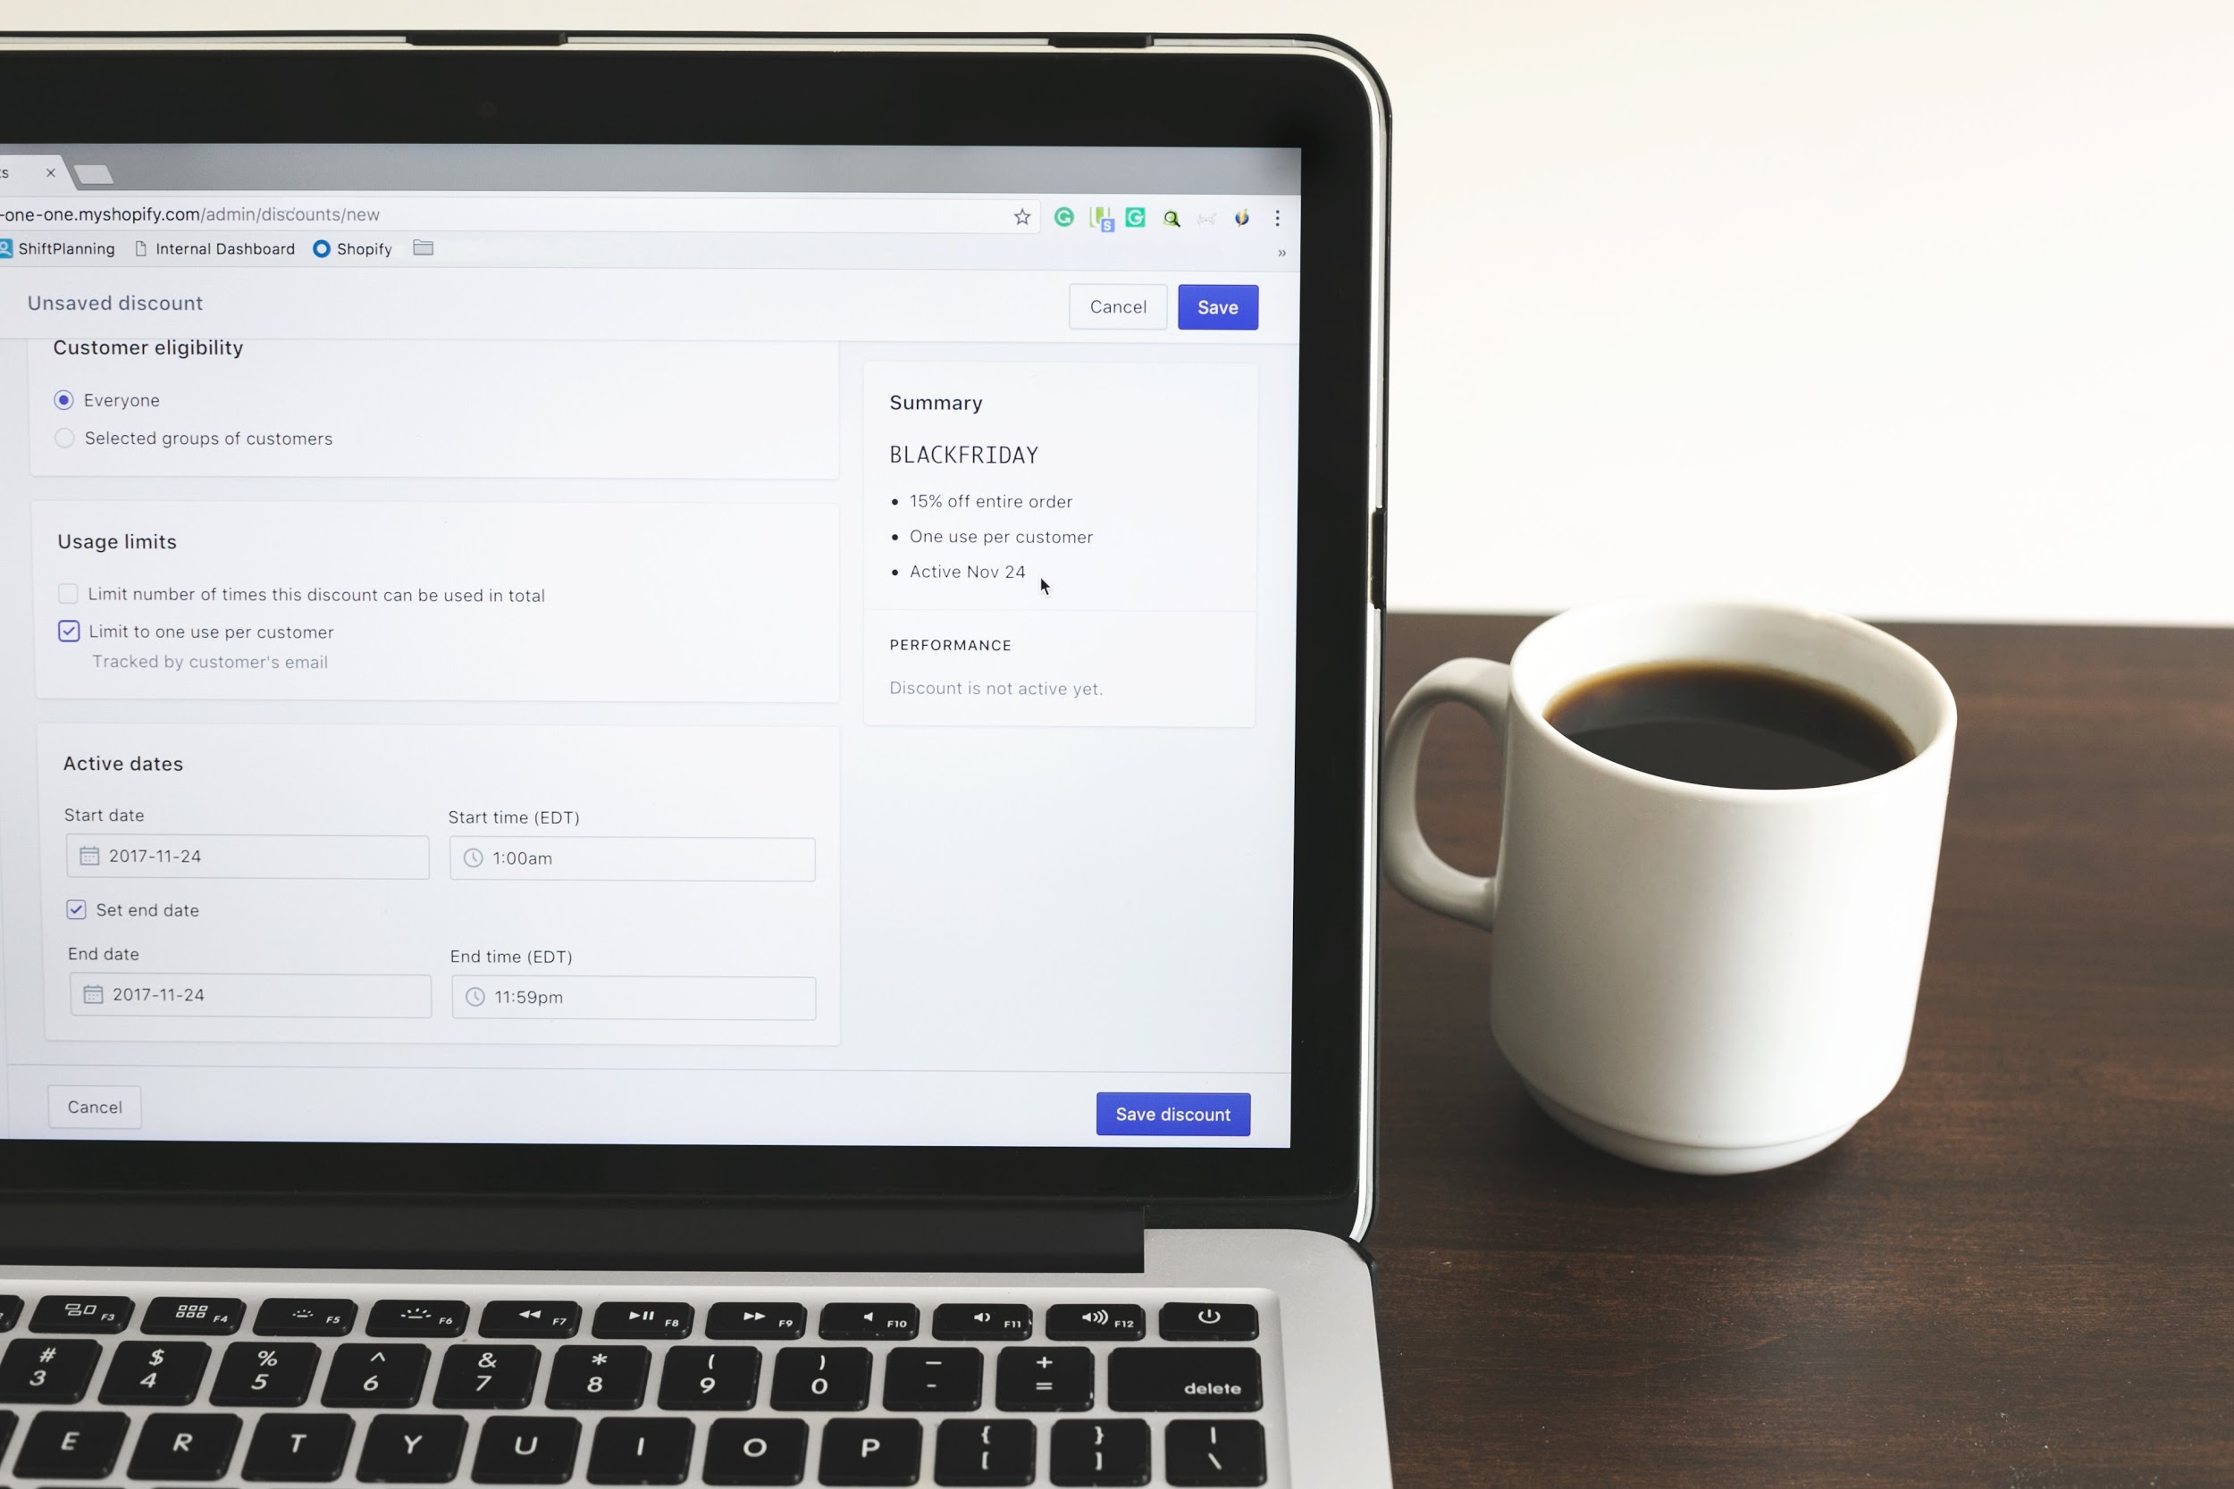
Discounts
€ based, percentage based, free shipping and Buy X Get Y discounts
Increase Average Order Value
Black Friday
Notes:
Promotions are a great way to incentivize both new and loyal customers to buy. Getting the right offer in front of the right people takes a lot of creativity and hard work. Discount codes can be generated for a dollar value discount, a percentage discount, a free shipping discount, or a Buy X Get Y discount. You can also specify the dates for which the code is valid, the number of times a code can be used, a minimum order amount before the code can be used, and to which products, collections, or variants the discount can be applied. All of this can be achieved in the Discounts section of your Shopify admin.
Discounts are great because they help to improve average Order value (AOV) by driving up cart size.

Slide 26
05
Manage

Slide 27
Shopify App Store
2400+ apps available
Free or paid
Wide range of add-on functionality to help you manage your business
Notes:
We’ve recently updated the app store, and it features better discoverability and categorization
Review system revisited - we allow for developers to now reply to reviews to offer better support
Dedicated team to mediate communications between merchants and developers
These apps work to expand on the functionality of our native integrations, as well as extend the use of your store
Apps are developed and supported by the developers themselves, and offer a wide range of opportunities and functionalities for users

Slide 28

Shopify Experts
780+ experts in our network
Global program
Wide range of services to suit your needs
Notes:
Plug the new services marketplace and explain when hiring a shopify expert would be useful.

Slide 29
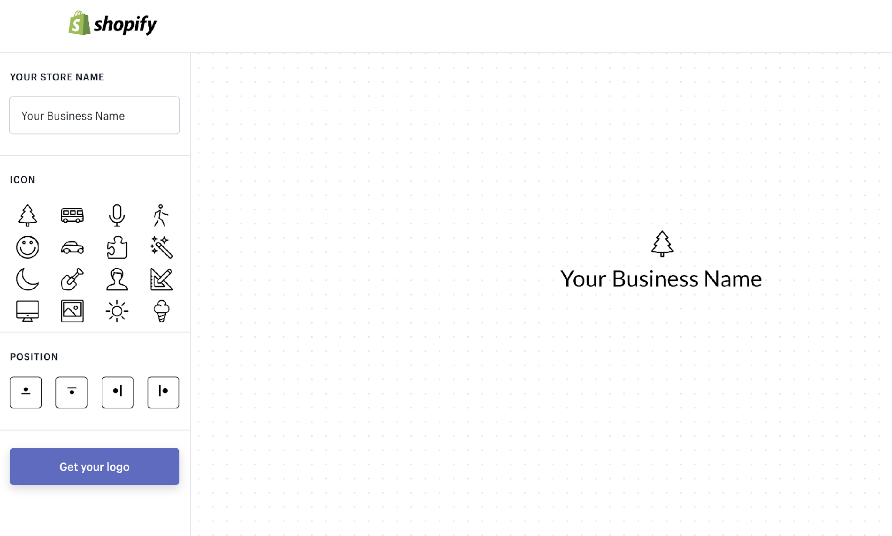
Hatchful
Logo generator
Business Name Generator
Slogan Generator
Notes:
We want to make sure that you’ve got everything you need to get your business started right at your fingertips. This is why we’ve also developed tools like the Logo Generator, Business Name Generator, and Slogan Generator so you can start and work on your branding to have a clear and crisp message to convey to your consumers.

Slide 30
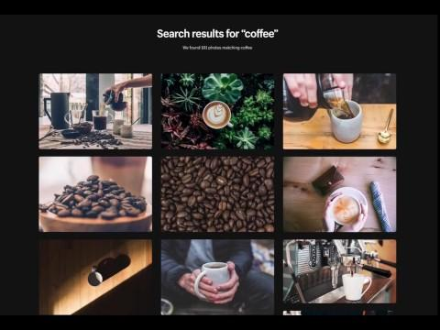
Burst
No cost
Royalty free
High quality
Thousands for photos
Notes:
Not everyone is a photography expert, so we’ve partnered with Burst to provide you with free, high quality photos to help build up your store. These can easily be changed and customized at any point to fit your branding, the season, and any special occasions your business might be marketing.

Slide 31
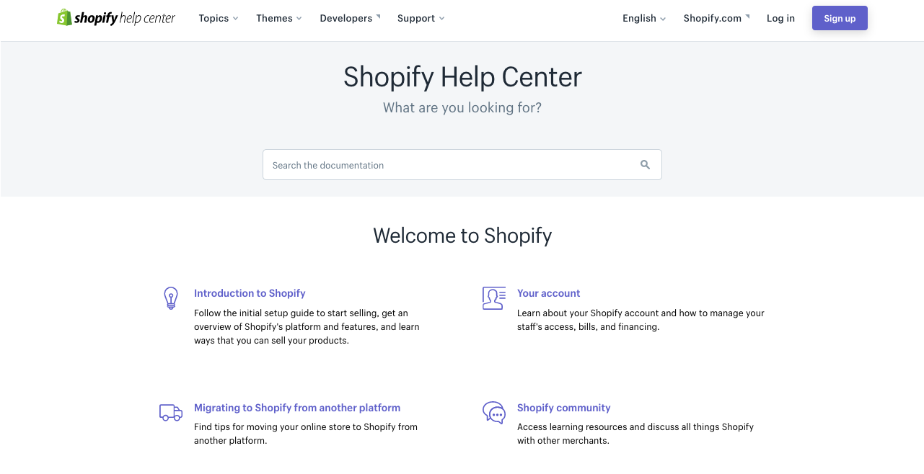
Help Center
Notes:
Talk about what is found in Help. easy to search, includes video tutorials.

Slide 32
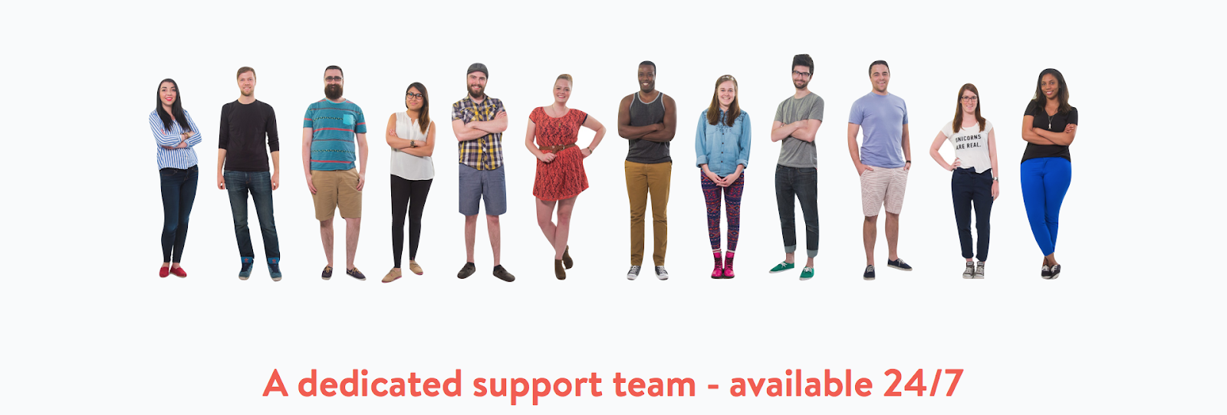
Support
Notes:
24/7 support - chat via admin or call

Slide 33
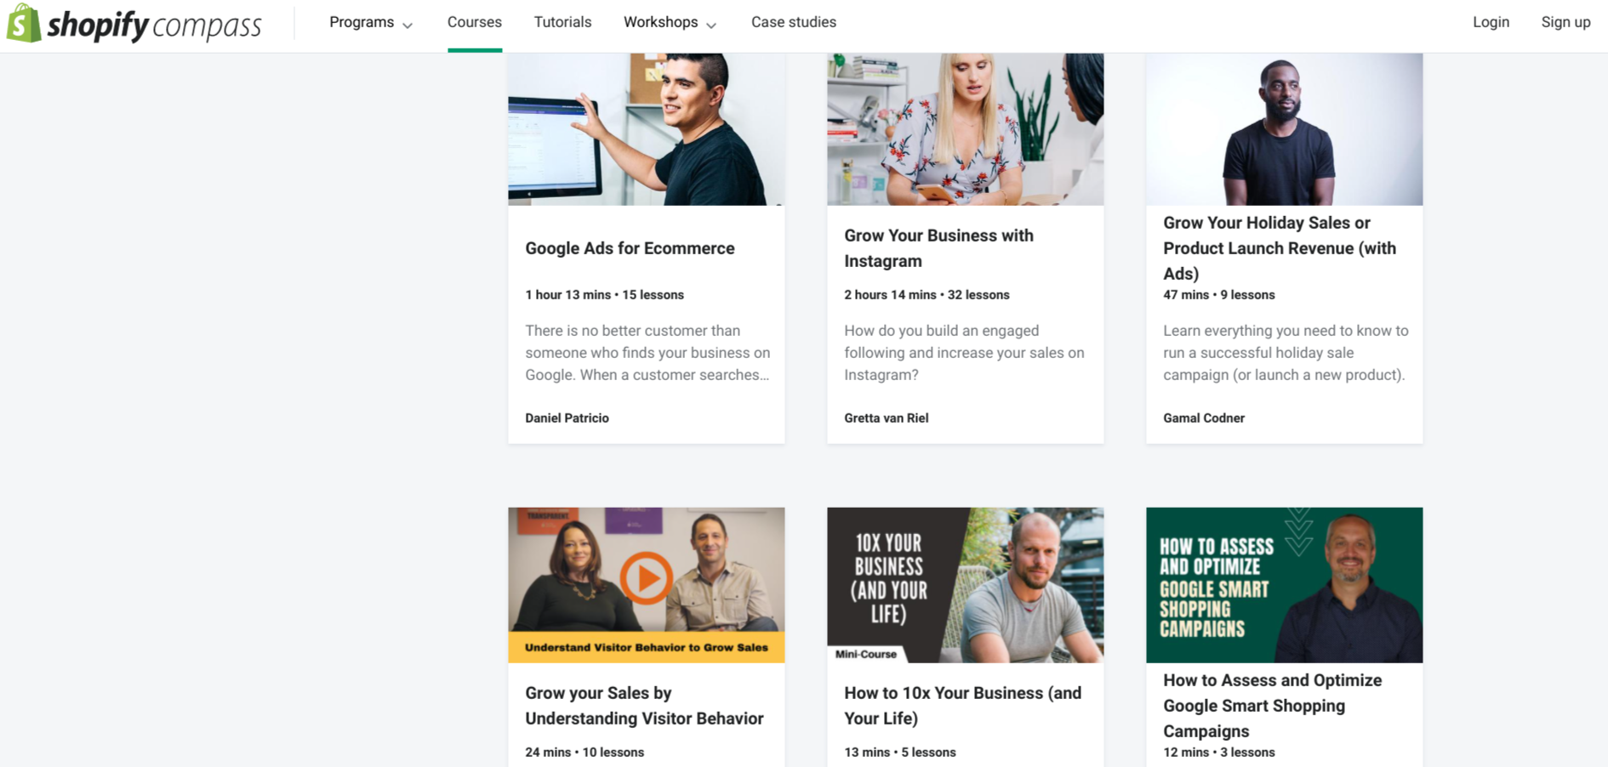
Shopify Compass
Notes:
Shopify Academy is an online course platform to help you grow your business. Totally free, great quality instructors.

Slide 34

The road ahead
Notes:
We are continuously working to improve our platform and add in new features to better serve our merchants, allowing you to better cater to your markets and customers
There is definitely a focus on growing internationally - so stay tuned as we will continue to develop and grow to serve merchants all around the world

Slide 35

“A goal without a plan is just a dream.” Antoine de Saint-Exupéry
Notes:
Say something inspiring here to encourage attendees to go and create trial stores. Remind them of the 14 days free.

Slide 36

Next steps:
What are three things that
you are going to action from this webinar?

Slide 37
Helpful Resources
Shopify Help Center | help.shopify.com
Shopify App Store | apps.shopify.com
Shopify Compass | shopify.com/compass
Shopify Podcast | shopify.com/podcasts/shopify-masters
Shopify Theme Store | Themes.shopify.com
Notes:
As a take home, here are some helpful resources for you to get started with Shopify.
Help Center
App Store
Theme Store
Academy
Podcast
Of course we have 24/7 Guru support and all of us here at the LA space to help you too!

Slide 38
Thanks!

